Slide 1
Broadband router user guide
Members:
Neira
Vilca Apaza Christian

Slide 2
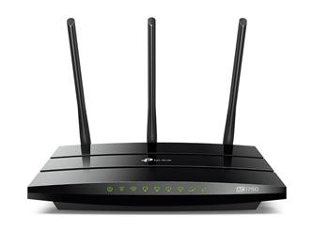
Router
To use the broadband router, your must properly configure the network settings of your Pcs and install the included setup program to setup the print server

Slide 3
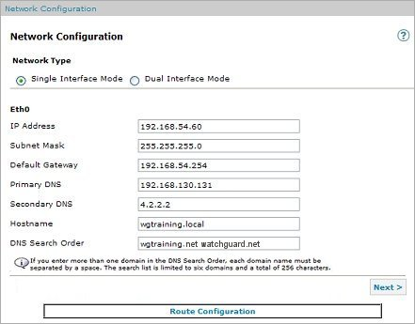
Configure the network settings
if the TCP/IP protocol is not yet configured on your PC refer to the TCP/IP installation procedure below. if the TCP/IP protocol is configured, perform the following steps to configure the broadband router.

Slide 4
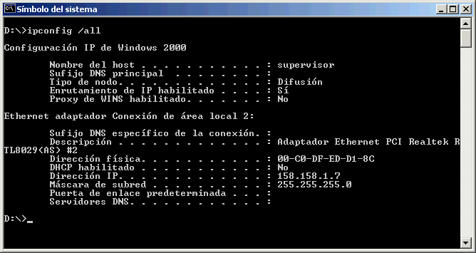
Steps
1. In Windows 95,98, and me, click Windows start and then run. In the run dialog box, type winipecfg and click ok. In Windows nt and 2000, click Windows start and the run. In the run dialog box, type command and click ok. Then click Windows start and then run again. Type ipconfig and click ok.

Slide 5
2. When the ip configuration window comes up, select your network adapter from the from-down menú. After you select your network adapter, the correct information for your network adapter from the drop-down menú. After be displayed. The default ip address of your ethernet card should be 192.168.123.xxx, when xx is any value between 100 and 199. The default subnet mask is 255.255.255.0 and the default Gateway is 192.168.123.254. if the correct values are not shown, click release and then click renew. If the correct values are still not shown, proceed to the troubleshooting section in this manual. Click more info and write down the carious addresses that are listed.

Slide 6
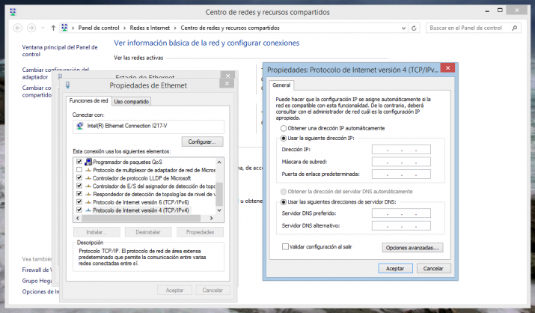

Slide 7
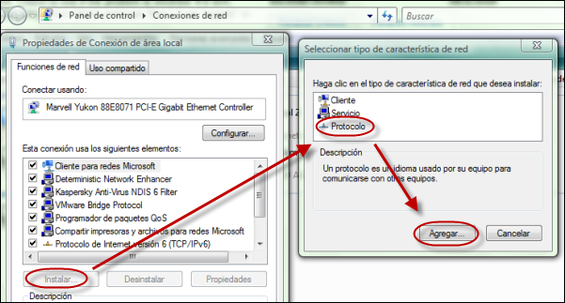
If the tcp/ip protocol is not configure don your pc, perform the following steps: Installing the tcp/ip protocol into your pc
In Windows 98 and me: click Windows start, settings and the click control panel. Doublé-click the network icon and select the configuration tab in the network window. Click add to add the network component into your pc. Doublé-click protocol to add the tcp/ip protocol. Select Microsoft in the manufacturers list.

Slide 8
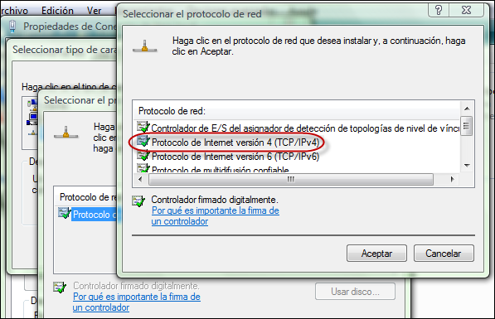
Choose tcp/ip in the network protocols and click ok to return to the network window. The tcp/ip protocol will be listed in the network window. Click ok to complete the installation procedure, then you must restart your pc.

Slide 9
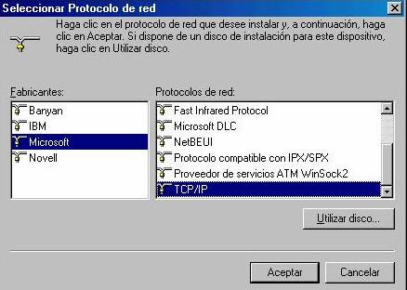
If the tcp/ip protocol is not configure don your pc, perform the following steps: Installing the tcp/ip protocol into your pc
In Windows 2000: click Windows start, settings, and the click control panel. Doublé-click network. Doublé-click local area connection and then click properties. Click install, click protocol, and then click add. Click tcp/ip and then click add. In Windows nt: click Windows start, settings, and then click control panel. Doublé-click network. Click protocols and click add. Select Microsoft, select tcp/ip then click close. Reapply any service packs, then restart your pc.

Slide 10
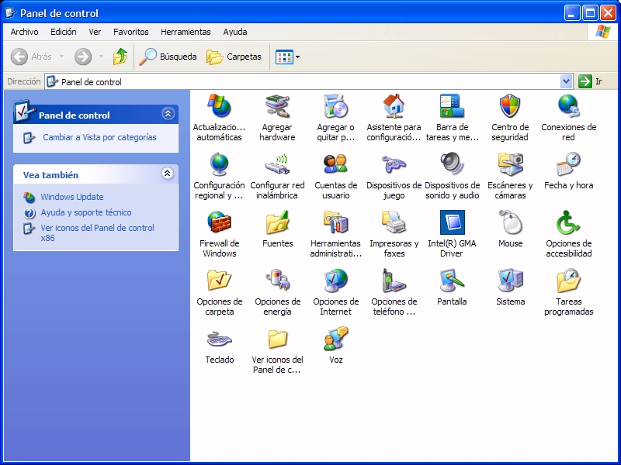
Setting the tcp/ip protocol to work with the broadband router
1. Click Windows start, settings, then click control panel

Slide 11
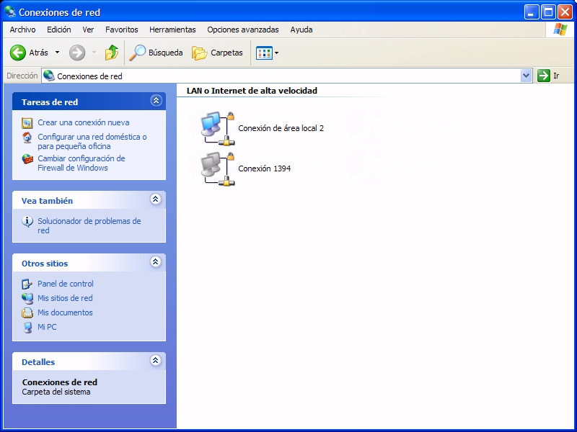
Setting the tcp/ip protocol to work with the broadband router
2. Doublé-click the network icon. Click the configuration tab and select the tcp/ip line that has been assigned to your network card.

Slide 12
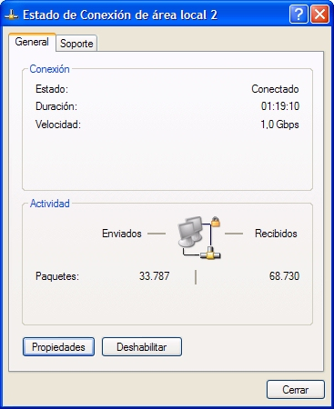
Setting the tcp/ip protocol to work with the broadband router
3. Click the properties button to set the tcp/ip protocol for the broadband router.

Slide 13
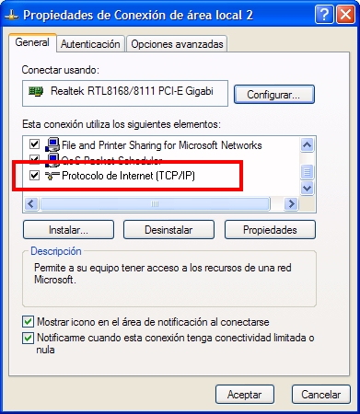
Setting the tcp/ip protocol to work with the broadband router
4. There are two setting methods to configure the ip:

Slide 14
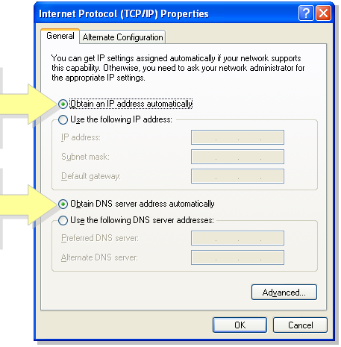
Setting the tcp/ip protocol to work with the broadband router
To obtain the ip automatically through the dhcp server, perform the following steps:
Click the ip address tab, and select obtain an ip address automatically.
To configure the ip manually, perform the following steps:

Slide 15
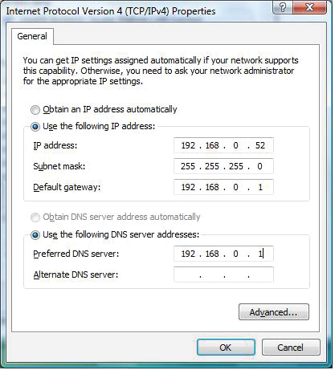
Setting the tcp/ip protocol to work with the broadband router
To configure the ip manually, perform the following steps:
a. Click the ip address tab. Click specify an ip address. Enter values in the ip address field and in the subnet mask field. The default ip address of this product is 192.168.123.254. you should use 192.168.123.xxx(xxx is between 100 and 199) for ip address field and 255.255.255.0 for subnet mask field.

Slide 16
Setting the tcp/ip protocol to work with the broadband router
To configure the ip manually, perform the following steps:
b. Click the Gateway tab. Add the ip address of this product(default i pis 192.168.123.254) in the new Gateway field and click add.
Contact your isp to get necessary dns values. Click the dns configuration tab. Add the dns values into the dns server search order field and click add.

Slide 17
Translate the following compound nouns into Spanish
Network settings(1) : ________________________________
Setup Program(2) : ________________________________
Dialog box(6) : ________________________________
Drop down menú(9) : _________________________________
Default dwn menú(11) : _________________________________
Default Gateway(12) : _________________________________
Troubleshooting section(14) : _____________________________
Configuration tab(19) :_______________________________
IP address field(39) :_______________________________
Subnet mask field(40) :_______________________________

Slide 18
Here you have a list of verbs taken from the text with the line where you can find them Write them next to the appropriate synonym
Do: ____________________________
Show : ____________________________
Appear: ____________________________
Install: _____________________________
Go to : _____________________________
Write : _____________________________
Go to : _____________________________
Setup(2) refer to(4) type(6)
Come up(9) display(11) proceed to(14)
Perform(28)

Slide 19
Search in the text the following Windows comands
Ejecutar : _______________________
Inicio : _______________________
Añadir : _______________________
Configuración : _______________________
Go to : _______________________
Renovar : _______________________

